Slide 1
Using Python to Compare Models and Plot Particle Distribution Following the Lagrangian Flow Network
By: Jessica Stevens

Slide 2
Introduction
Weisberg et al. Fig. 10
Transport, dispersal and connectivity within and outside of the Gulf of Mexico (GoM) due to the effects of the Loop Current (LC) is a crucial process to understand.
Notes:
Transport, dispersal and connectivity within and outside of the Gulf of Mexico due to the effects of the Loop Current is a crucial process.
Warm, tropical waters enter the Gulf through the Yucatan Chanel forming the Loop Current.
The LC has 3 main states: 1) retracted, where the LC barely penetrates the GoM, and the connection between the Yucatan and Florida Currents is short, 2) extended, where the LC extends north, up to the Texas-Louisiana shelf break, bringing Caribbean waters into the GoM, and 3) detached, a transitional state where the LC releases an anti-cyclonic warm-core eddy containing Caribbean waters that then travels westward within the GoM.
These eddies can entrap nutrients, phytoplankton, and other small, non-motile organisms (Sebille, et al., 2017).

Slide 3
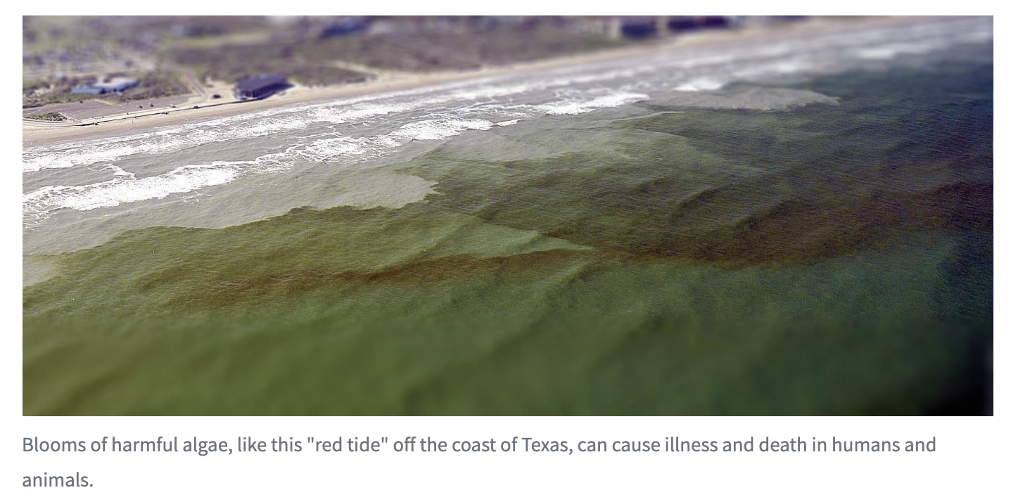
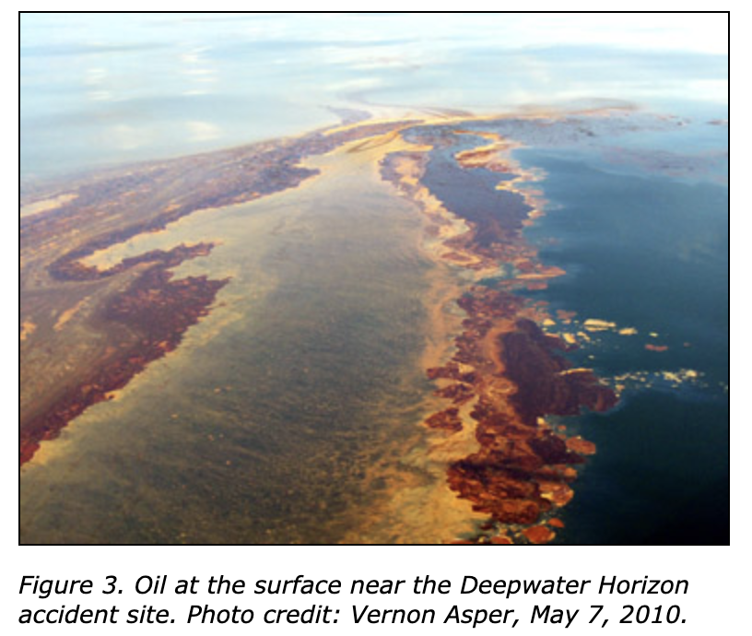
Background
Biological transport
ex. Mesophotic coral connectivity
Retention processes
Ex. Harmful algal blooms, Red Tide
Pollutant transport
Ex. Deepwater Horizon oil spill
(US Department of Commerce & National Oceanic and Atmospheric Administration 2019)
https://gcrl.usm.edu/whaleshark/oil.impact.php.
Notes:
This research connects to societally and economically relevant processes, such as biological transport and connectivity, retention processes leading to harmful algal blooms, and pollutant transport. For example, given spawning sites of mesophotic corals the LC and its eddies need to be known to determine connectivity between sites. Harmful algal blooms such as the red tide have been a nuisance to coastal communities around the GoM. When there’s a level of upwelling and an entrapment of nutrients these blooms occur, which are known to kill many fish populations and even make the coastal air toxic to breathe. Pollutant transport, such as what was seen with the Deepwater Horizon oil spill, relies on the LC. If an eddie hadn’t been shed, Florida’s MPA would’ve taken a lot of damage.

Slide 4
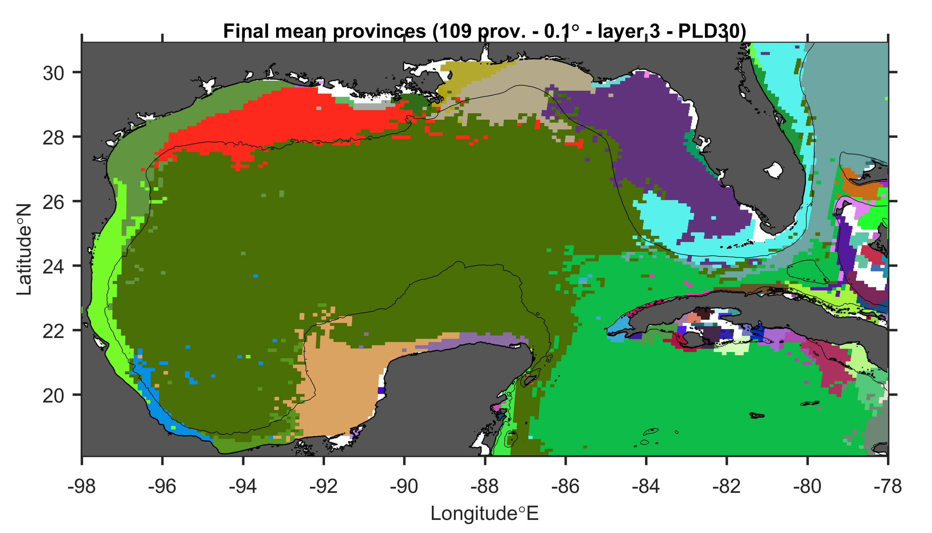
Research Question
Does the flow of the Loop current create connectivity patterns in the gulf of Mexico?
Hypothesis: Yes, it does create connectivity matrices across the Gom.
Preliminary connectivity matrix in the Gulf of Mexico by Enrico Ser-Giacomi, Vincent Rossi, and Cheryl Harrison

Slide 5
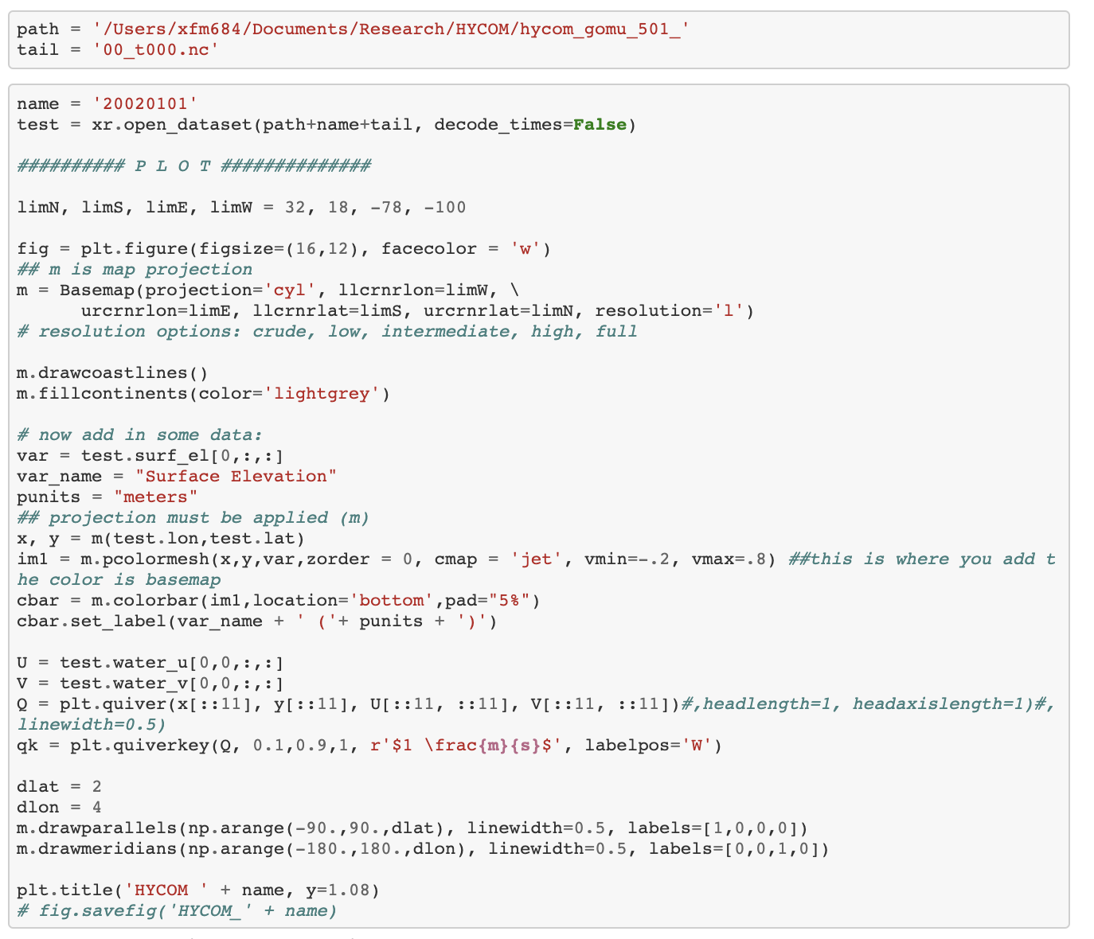
Methods
Using Network Theory and Lagrangian oceanographic modeling (Lagrangian Flow Networks, LFN) along with self-organizing maps, we will assess ocean climate states.
Notes:
GoM reanalysis from HYCOM imported to xarray
Plot sea surface elevation and use quiver plot to show velocity vectors over surface elevation.
Using one month.
GECKO plotted same way.
Never mind on the LFN stuff because my computer died.

Slide 6
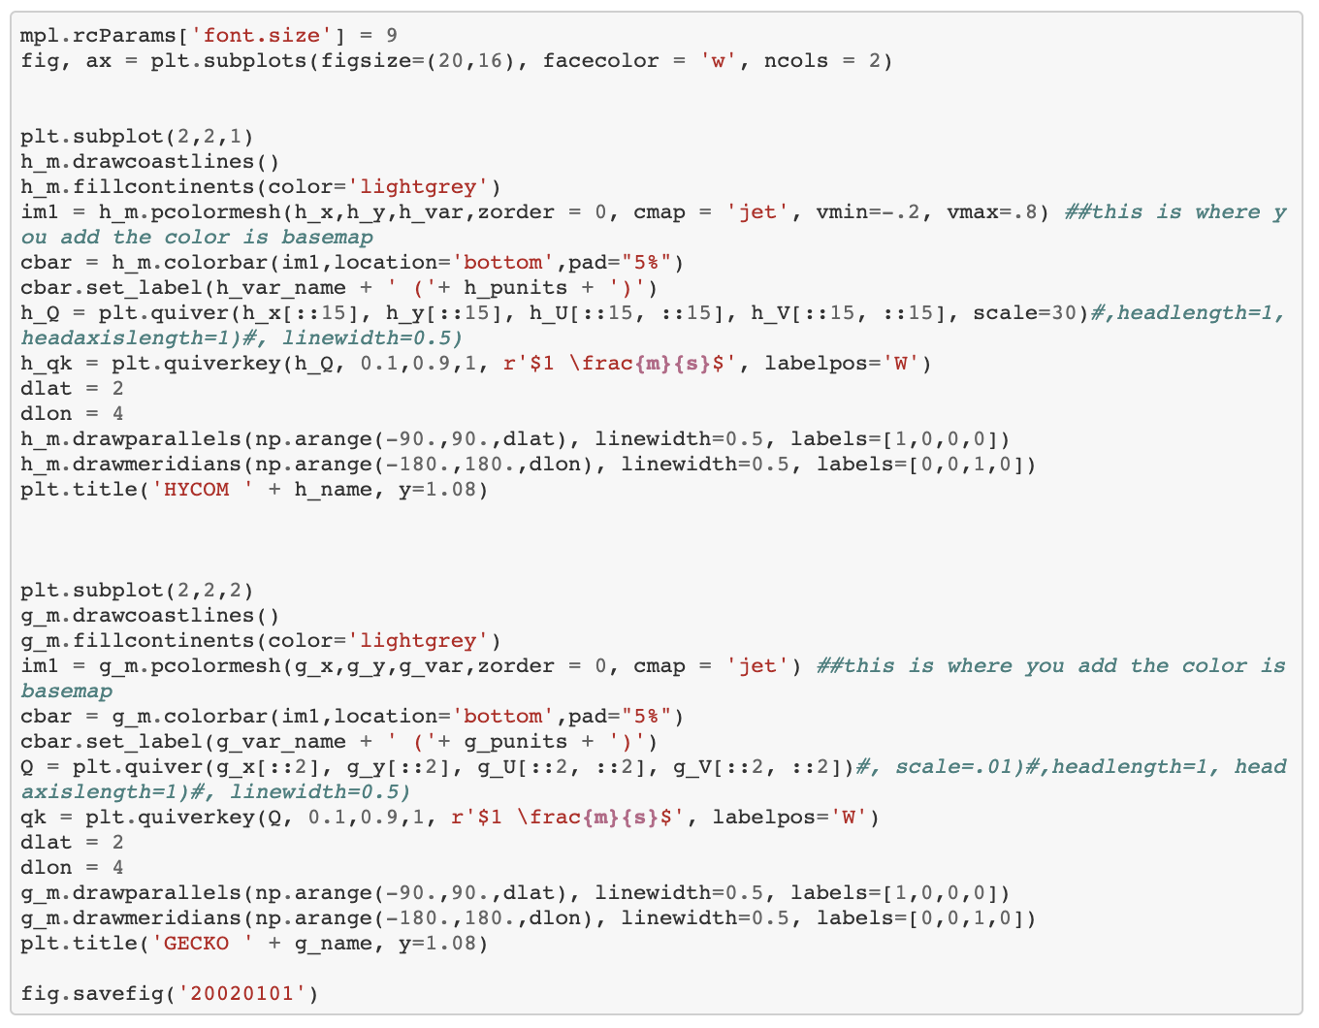
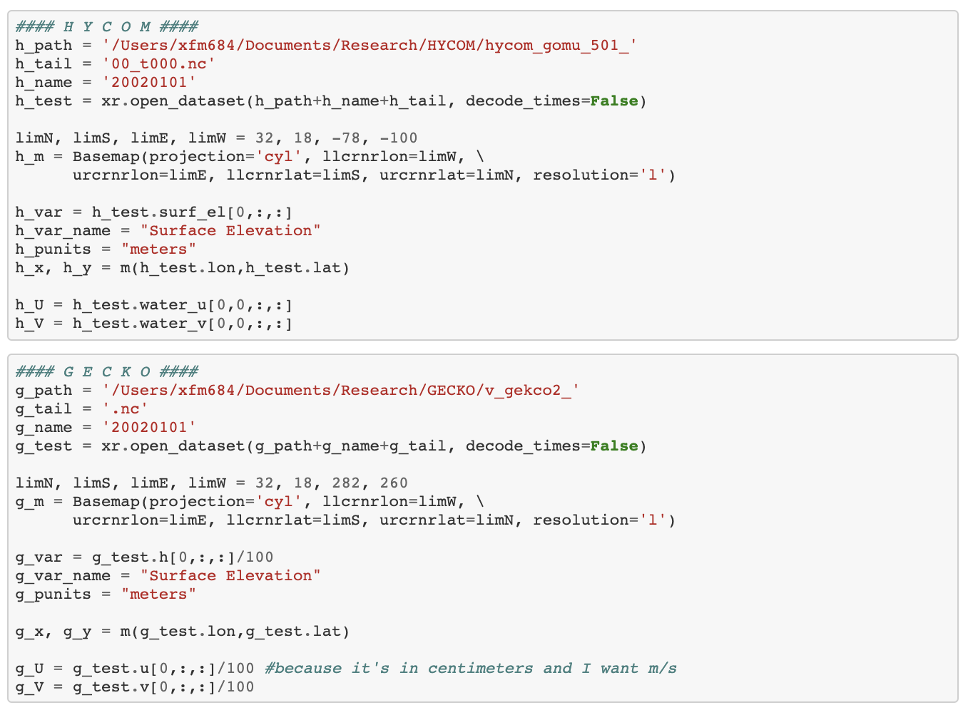
Hycom and gecko plots

Slide 7
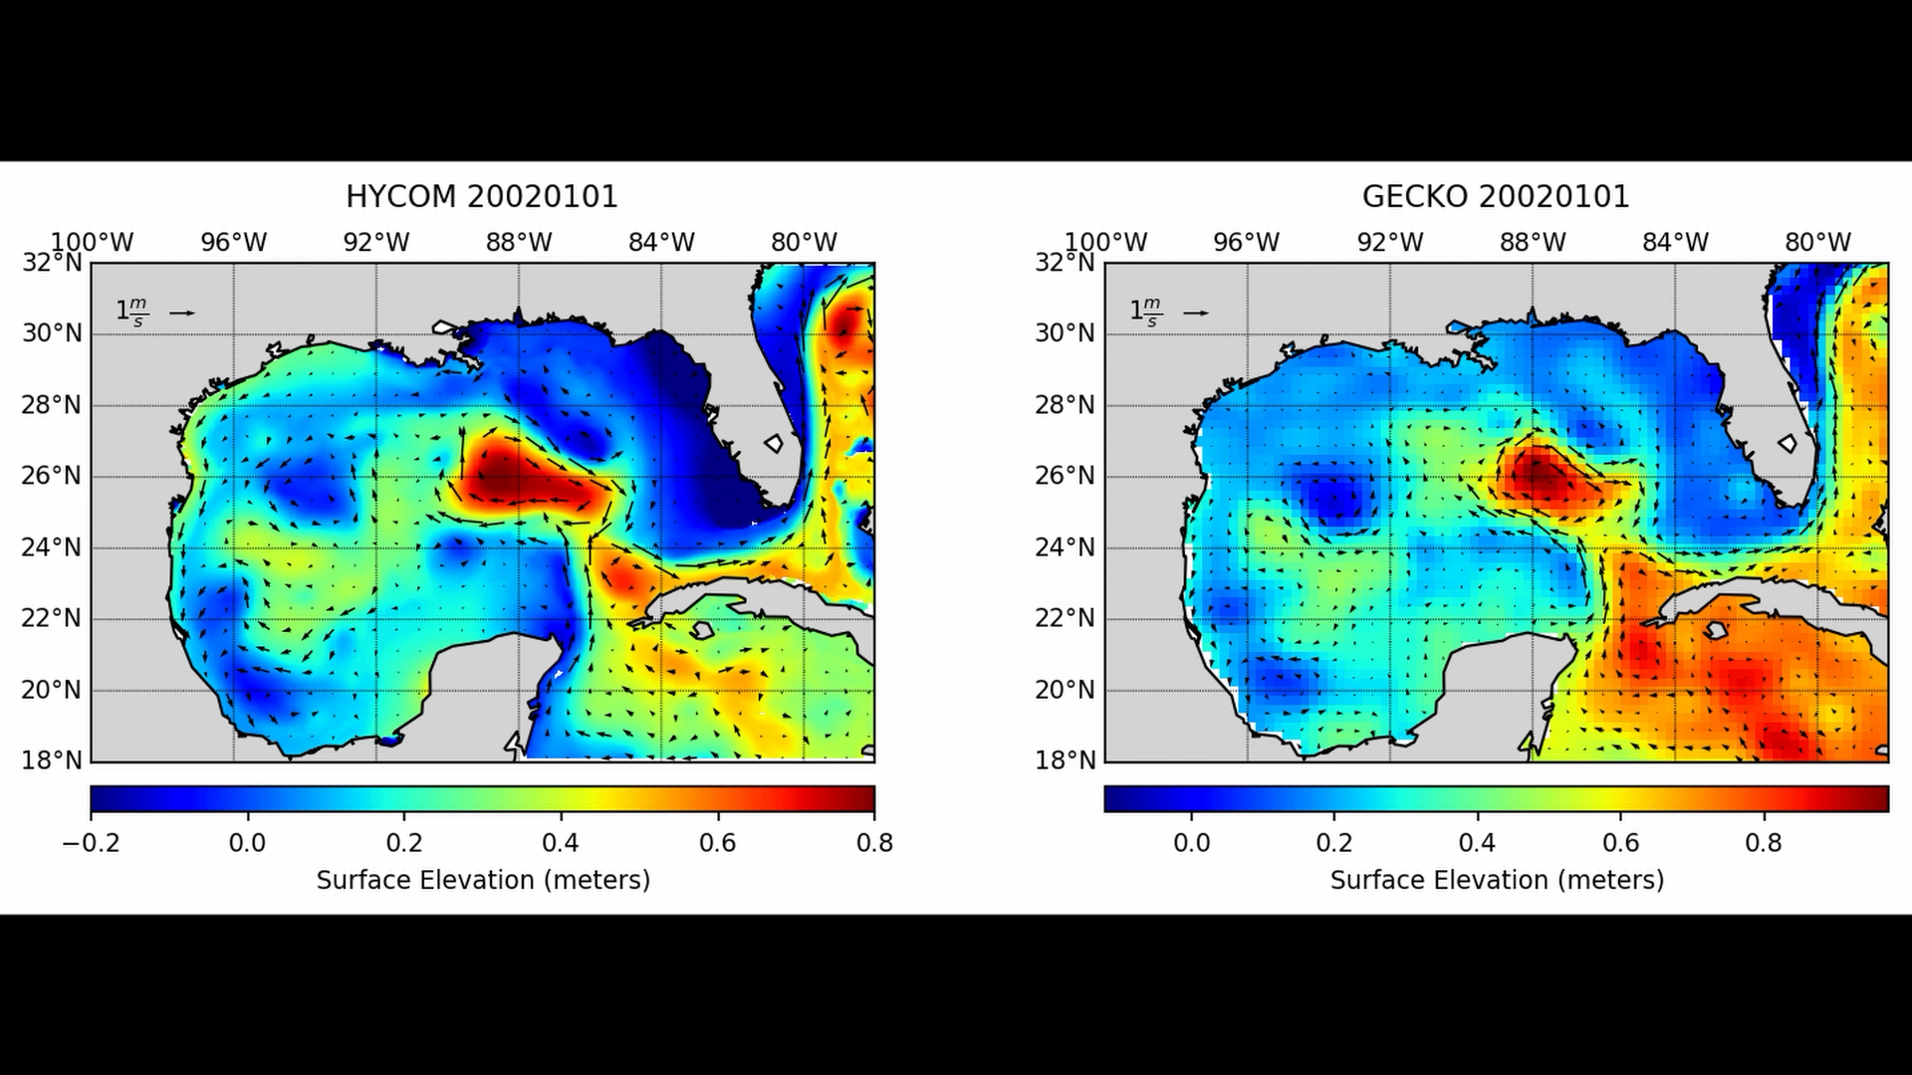
Results
Hycom and Gecko model output are in agreeance
Notes:
Here we can see that the models resemble each other closely. In these plots I did adjust the HYCOM colorbar to more similarly match the GECKO output. They use different techniques to normalize their data which gives slightly different results, but the overall movement in the gulf due to the LC remains similar.

Slide 8
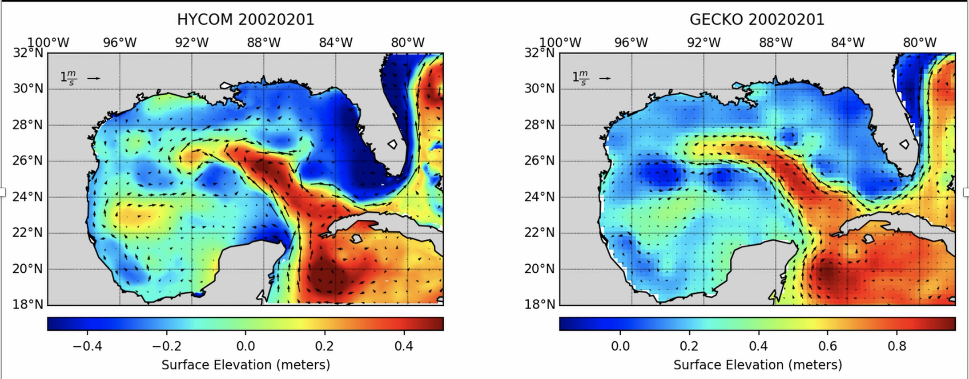
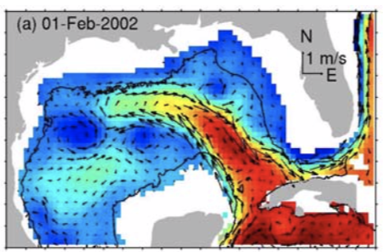
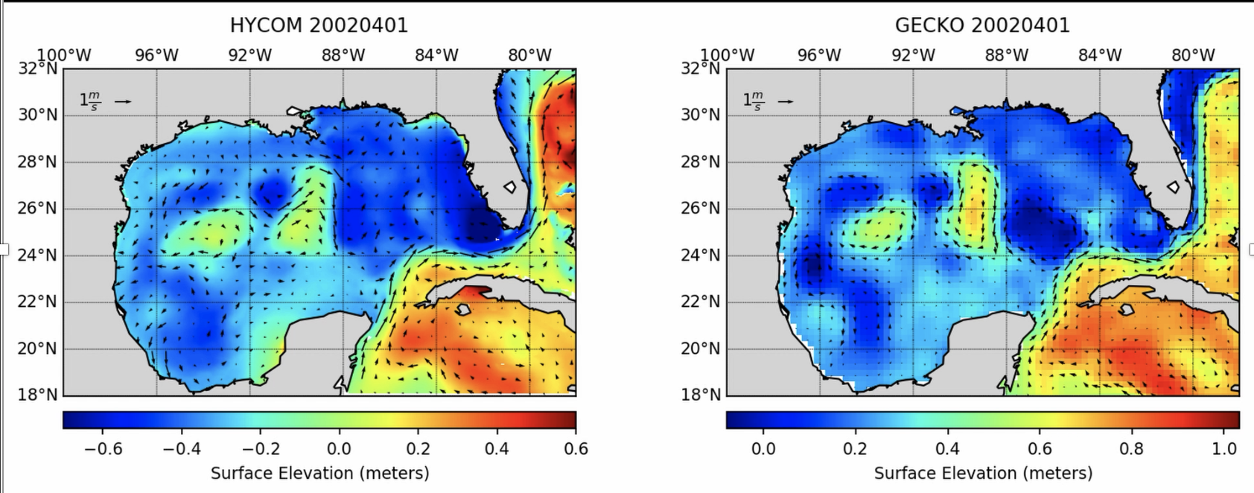
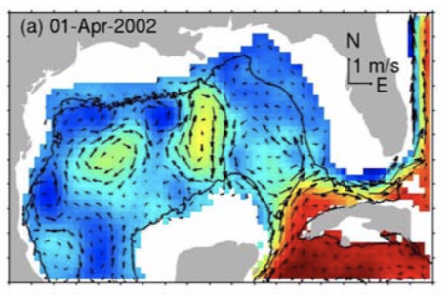
HYCOM Gecko and Weisberg et al.
Weisberg et al. Fig. 3
Weisberg et al. Fig. 4
Notes:
Unfortunately, I couldn’t re-run the analysis of hycom and gecko because I was having issues installing xarray on anaconda, but here are some snapshots from the plots I obtained from the movie to compare to some of the Weisberg et al. figures. HYCOM doesn’t have data past 2012 currently so I couldn’t compare the monthly snapshots. They did however have a run of February and April where Weisberg et al. plotted every 3 days. I was able to take the first day of these two months to compare to my output due to my restrictions.
We are able to see similar loop current behavior and elevations. The velocity vectors seem to agree. Eddy placements are also very similar.

Slide 9
Discussion
Matrix construction wasn’t completed on time to answer the hypothesis.
HYCOm and gecko model output agreeance offers confidence in the likely accuracy of the lfn output
HYCOM and gecko output agrees with the Weisberg et al. figures.
~Back up your data constantly~

Slide 10
Questions?

